Slide 1
ROCO218: Control Engineering Dr Ian Howard Lecture 3 Brief introduction to Laplace transforms

Slide 2
Definition of Laplace transform
The Laplace transform is a linear operator that maps a function f(t) to F(s).
Specifically:
where:
It maps from a time domain representation with real input to an angular frequency representation which is complex.
We can use integral to calculate Laplace transforms of functions – but it can be hard work!

Slide 3
Laplace transform of the unit step
For t < 0 output zero
For t > zero, output constant value
For the step unit function
Since

Slide 4
Laplace transform of exponential function
For step negative exponential function
Since

Slide 5
Laplace transform of sine function
For sin function
Using integration by parts
We let

Slide 6
Laplace transform of sine function
So now we have
Now dealing with right hand term
Using integration by parts again
We let

Slide 7
Laplace transform of sine function
So from
Substituting in
As we can see doing analytical solutions to get Laplace transforms of functions starts to get tricky!
So its better to use tables!

Slide 8
Common useful Laplace transforms
Delta function
Unit step
Rising exponential
Decaying exponential
Ramp
Sine
Cosine

Slide 9
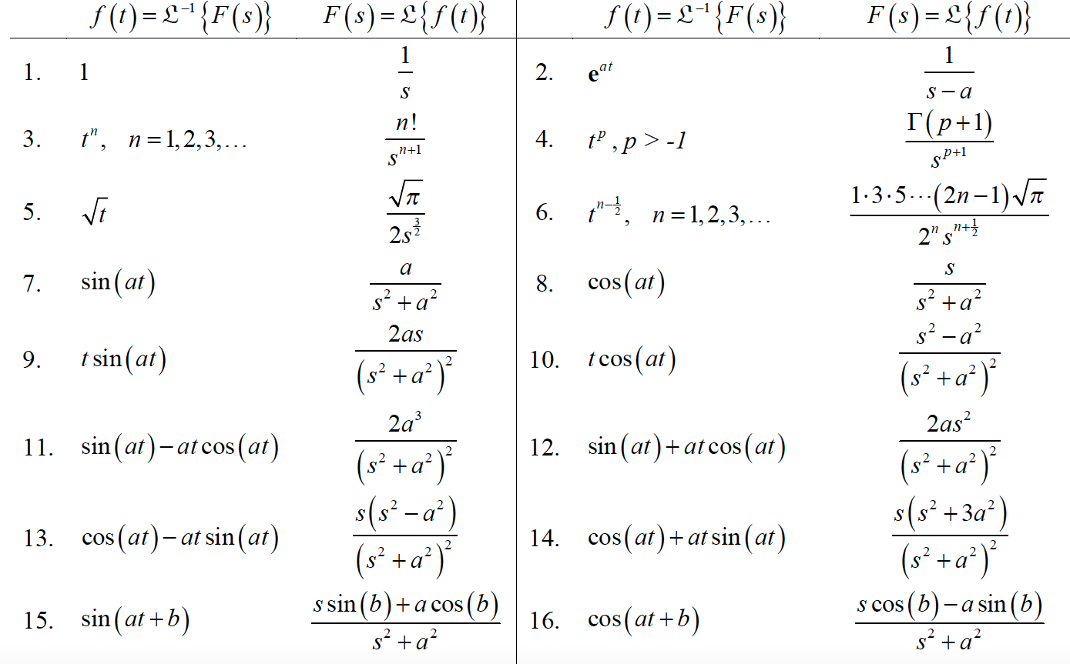
Table of Laplace transform pairs

Slide 10
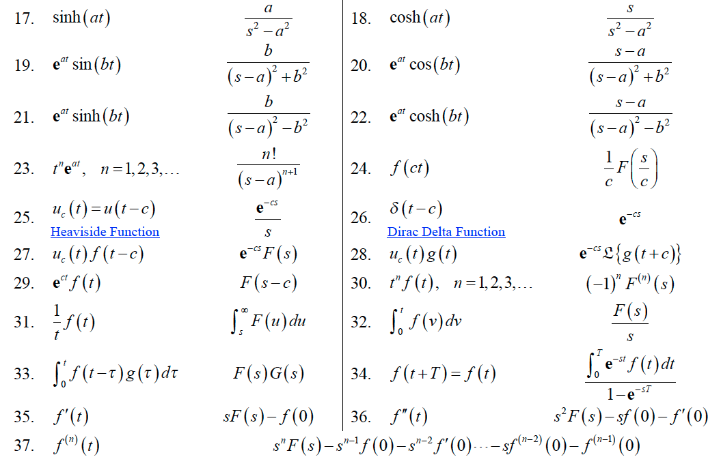
Table of Laplace transform pairs

Slide 11
ROCO218: Control Engineering Dr Ian Howard Lecture 3 Inverse Laplace transforms

Slide 12
Inverse Laplace Transforms by identification
The inverse transform is formed in order to determine the time response.
For example, when a differential equation is solved by Laplace transforms, the solution is obtained as a function of the variable s.
The simplest forms are those that can be recognized within the tables and a few of those will now be considered.

Slide 13
Example 1: Determine inverse transform
Given the Laplace transformation
From Laplace transform pairs table we see that
Thus the inverse Laplace transform gives the time solution

Slide 14
Example 2: Determine inverse transform
Given the Laplace transformation
From Laplace pairs table we see that
Thus the inverse Laplace transform gives the time solution

Slide 15
Example 3: Determine inverse transform
Given the Laplace transformation
Look at denominator terms and try to write in standard form

Slide 16
Example 3: Determine inverse transform
Look at numerator terms and try to write in standard form

Slide 17
Example 3: Determine inverse transform
Can now use tables to get inverse Laplace transform
From Laplace pairs table we see that
Thus the inverse Laplace transform gives the time solution

Slide 18
Partial fraction expansions
Often we will have transfer function is form that we cant directly relate to expressions in Laplace transform tables
Then we can try to use partial fraction expansions
Partial fractions are several fractions whose sum equals a given fraction
Working with transforms requires breaking complex fractions into simpler fractions to allow use of tables of transforms
Consider the transfer function:

Slide 19
Example partial fraction expansion
Expand into a term for each factor in the denominator.
Now multiply top and bottom on both RHS with terms so both denominators are the same
Recombining RHS

Slide 20
Example partial fraction expansion
From
Equate terms in s
Equate constant terms.
From 1st equation
Substituting A into 2nd equation
So: B=2, A=-1
Each term is now in a form so that inverse Laplace transforms can be applied.

Slide 21
ROCO218: Control Engineering Lecture 3 Laplace procedure for Solving DEs

Slide 22
Laplace transform of 1st time differential
Laplace transform of 1st order differential
Using integration by parts
We let
and

Slide 23
Laplace transform of 1st time differential
From
and
Since
Where f(0) is the function's initial value at t=0

Slide 24
Laplace transform of time integral
Laplace transform of integral
where
Using integration by parts
We let
and

Slide 25
Laplace transform of time integral
We let
and
Since
and

Slide 26
Summary of operations for solving differential equations
Laplace transform of 1st order differential
Where f(0) is the function's initial value at t=0
Laplace transform of 2nd order differential
Where f(0) is the function's value at t=0 and f’(0) is the1st derivative value value at t=0
Laplace transform of integral

Slide 27
General Laplace procedure for Solving DEs
Consider a 2nd order differential equation
Taking Laplace transforms and accounting for initial conditions

Slide 28
General Laplace procedure for Solving DEs
From the equation
Grouping Y(s) terms
Response Y(s) then given by
Driving function F(s)
Initial conditions terms

Slide 29
Example 1: Laplace solution of an ODE
ODE with zero initial conditions
Apply Laplace transform to each term
Laplace transform of step
Solve for Y(s)
Apply partial fraction expansion

Slide 30
Example 1: Laplace solution of an ODE
From
Recombining RHS
Equating terms

Slide 31
Example 1: Laplace solution of an ODE
From the first equation
From the second equation
From the third equation
Putting this back into the second equation

Slide 32
Example 1: Laplace solution of an ODE
This gives the final partial fraction representation
From Laplace pairs table we see that
Thus the inverse Laplace transform gives the time solution

Slide 33
Example 2: Laplace solution of an ODE
Consider 1st order differential equation with non-zero Initial conditions
Taking Laplace transforms and accounting for initial conditions
Laplace transform of step

Slide 34
Example 2: Laplace solution of an ODE
From
Simplifying second term using partial fractions
Equating terms

Slide 35
Example 2: Laplace solution of an ODE
Therefore
From Laplace pairs table we see that
Thus the inverse Laplace transform gives the time solution

Slide 36
ROCO218: Control Engineering Dr Ian Howard Lecture 3 Laplace initial and final value theorems

Slide 37
Initial value theorem
Initial value theorem gives the initial value of f(t) when t is zero
If the function f(t) and its first derivative are Laplace transformable and f(t) has the Laplace transform F(s) and
exists
Then
Initial Value Theorem

Slide 38
Initial value theorem
Procedure:
1) Given a transfer function X(s)
First find the response F(s) of the transfer function X(s) by multiplying it by the Laplace transform of the requested driving function
E.g. if input unit step then
2.) Next multiply F(s) by s
3.) Take the limit of sF(s) as s goes to infinity
4.) The result is the value of f(t) when t =0
The utility of this theorem lies in not having to take the inverse of F(s)
in order to find out the initial condition in the time domain. This is
particularly useful in circuits and systems.

Slide 39
Final value theorem
Final value theorem gives the initial value of f(t) when t goes to infinity
If the function f(t) and its first derivative are Laplace transformable and f(t) has the Laplace transform F(s) and if
exist
Then
Final Value Theorem

Slide 40
Final value theorem
Procedure:
1) Given a transfer function X(s)
First find the response F(s) of the transfer function X(s) by multiplying it by the Laplace transform of the requested driving function
E.g. if input unit step then
2.) The multiply F(s) by s
3.) Take the limit of sF(s) as s goes to zero
4.) The result is value of f(t) when t = infinity
Again, the utility of this theorem lies in not having to take the inverse
of F(s) in order to find out the final value of f(t) in the time domain.
This is particularly useful in circuits and systems.

Slide 41
Example: Initial- and final-value
Laplace transform of the function.
final-value theorem
initial-value theorem

Slide 42
Interlude 10 minute break

Slide 43
ROCO218: Control Engineering Dr Ian Howard Lecture 3 Complex numbers

Slide 44
Definition of an imaginary number
The square root of a negative real number is not a real number.
Thus, we introduce imaginary numbers by letting
Therefore
A complex number has a real part and an imaginary part
Its standard form is:
Real part
Imaginary part
Example: z = 5+4i
Rel(z} = 5
Img{z } = 4

Slide 45
Complex number manipulation
Each complex number of the form
a + bi
has a conjugate of the form
a – bi
The product of a complex number and its conjugate is a real number
(a + bi )(a - bi ) = a² + b²
Two complex numbers
a + bi and c + di
are added by adding real number parts and imaginary coefficients respectively
(a + bi ) + (c + di ) = (a + c) + (b + d )i
are subtracted by subtracting real number parts and imaginary coefficients respectively
(a + bi ) - (c + di ) = (a - c) + (b - d )i

Slide 46
The complex plane – Argand diagrams
Imaginary Axis
Just like 2 components vectors
complex numbers represent both magnitude and direction
b
Real Axis
O
a
The magnitude or modulus z is defined as the distance from the origin to the point (x, y).
The modulus of z is denoted by

Slide 47
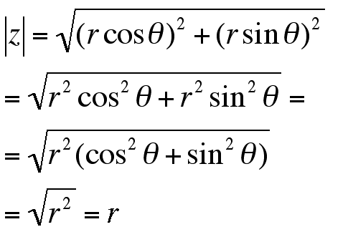
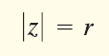
Converting cartesian to polar forms
Cartesian Form
Polar Form

Slide 48
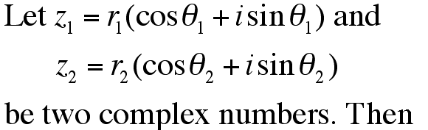
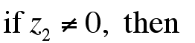
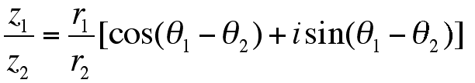
Product and quotient theorem in polar form
Product theorem
Quotient theorem

Slide 49
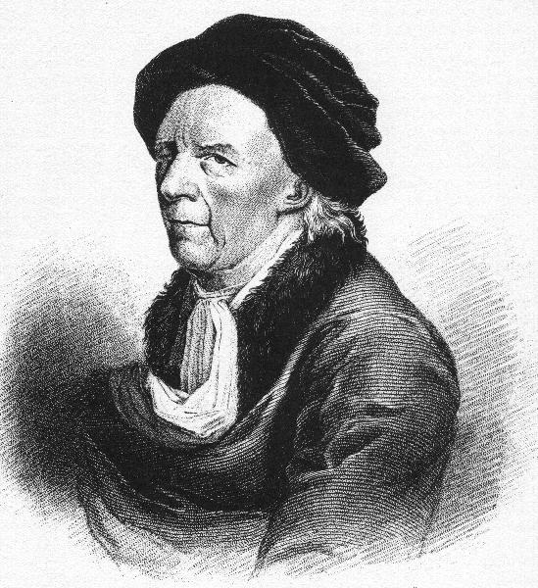
Further useful identities
Euler: e^{ix} = cos x + i sin x
cos x = (e^{ix} + e^{-ix})/2
sin x = (e^{ix} - e^{-ix})/2i
DeMoivre’s Theorem
Raising a unit z to the n^{th} power is equivalent to multiplying its angle by n

Slide 50
ROCO218: Control Engineering Dr Ian Howard Lecture 3 Brief introduction to Fourier analysis

Slide 51
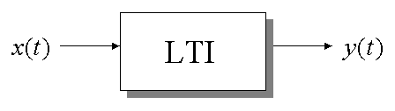
Frequency response methods
The sinusoid is a unique input signal
Resulting output signal y(t) for a linear time invariant system with sinusoidal input x(t) is sinusoidal in the steady state
Output differs from the input waveform only in amplitude and phase angle
Issue in frequency response methods is how to describe the amplitude and phase angle of the system

Slide 52
Background to Fourier analysis
Any function that periodically repeats itself can be expressed as the sum of sines and/or cosines of different frequencies, each multiplied by a different coefficient (Fourier series).
Even functions that are not periodic (but whose area under the curve is finite) can be expressed as the integral of sines and/or cosines multiplied by a weighting function (Fourier transform).
There are different ways to represent a function of signal
We can expand out functions
For example the Taylor Series
constant
first-order
term
second-order
term
…

Slide 53
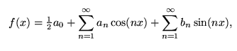
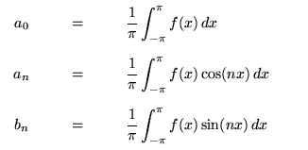
Fourier series expansion
Fourier series make use of the orthogonality relationships of
the sine and cosine functions

Slide 54
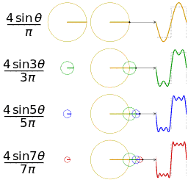
Illustration of square wave approximation

Slide 55
Fourier Transform
The Fourier transform is a generalization of the complex Fourier series in the limit
Fourier analysis = frequency domain analysis
Low frequency: sin(nx),cos(nx) with a small n
High frequency: sin(nx),cos(nx) with a large n
Note that sine and cosine waves are infinitely long – this is a shortcoming of Fourier analysis, which explains why a more advanced tool, wavelet analysis, is more appropriate for certain signals

Slide 56
Fourier Series in exponential form
Consider the Fourier series of the 2T periodic function:
Using the Euler formula
It can be rewritten as
With the decomposition coefficients calculated as:
Notes:
Outline:
Central Scientific Problem – Artificial Intelligence
Machine Learning:
Definition
Specifics
Requirements
Existing Solutions and their limitations
Multiresolution Approximation: Limitation
Our Approach. Results. Binarization. Plans.

Slide 57
Summary of Fourier Transform
A continuous time (CT) signal x(t) and its frequency domain, Fourier transform signal, X(jw), are related by
analysis
synthesis
This is denoted by:
For example:
Where u(t) is a step signal.
Often you have tables for common Fourier transforms
The Fourier transform, X(jw), represents the frequency content of x(t).
It exists either when x(t)->0 as |t|->∞ or when x(t) is periodic (it generalizes the Fourier series)

Slide 58
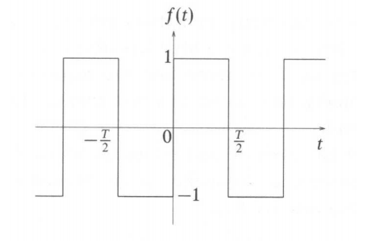
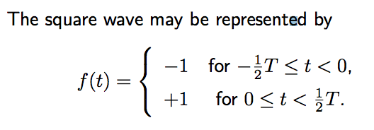
Fourier series of a square wave

Slide 59
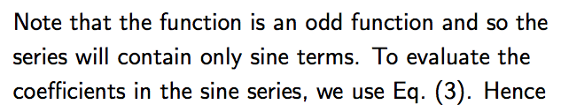
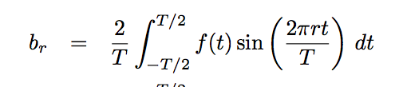
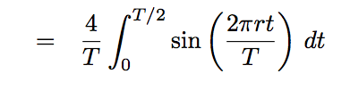
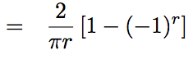
Fourier series of a square wave

Slide 60
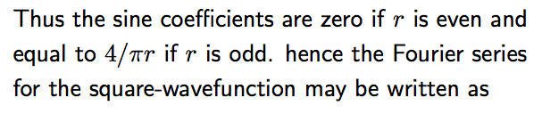
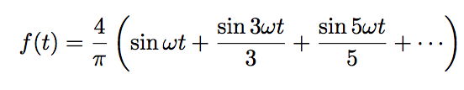
Fourier series of a square wave

Slide 61
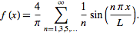
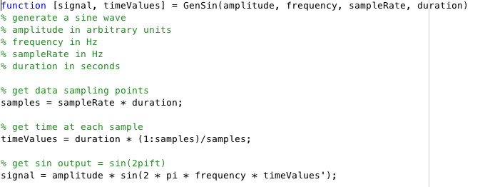
Fourier series of a square wave
The Fourier decomposition of a square wave is given by
Write a Matlab GenSin function
Takes parameters amplitude, frequency, sampleRate and duration

Slide 62
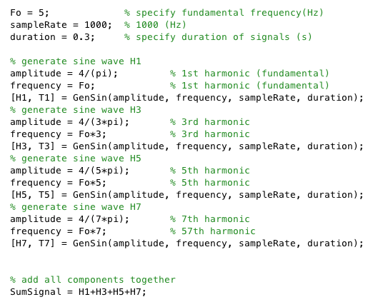
Synthesize a square wave in Matlab
Generate four sine wave signals H1, H3, H5 and H7 representing the first 4 Fourier coefficients.
Use sampleRate = 1000.

Slide 63
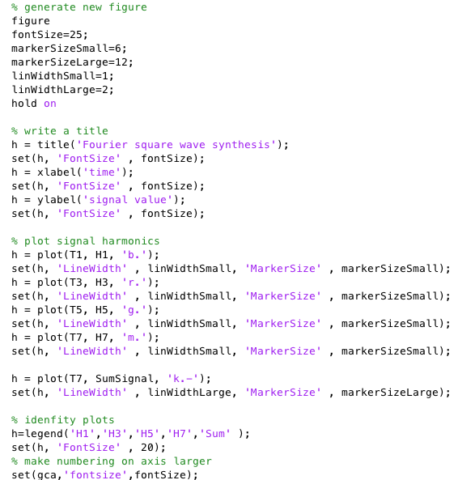
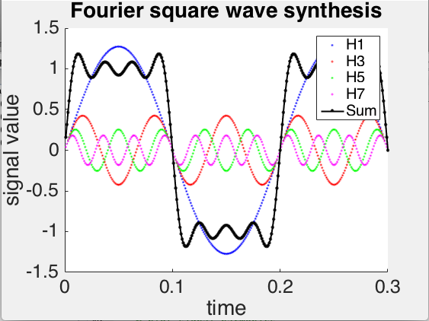
Synthesize a square wave in Matlab
Slowly approximates the square wave.
We need more harmonic components to get a better approximation.

Slide 64
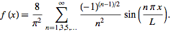
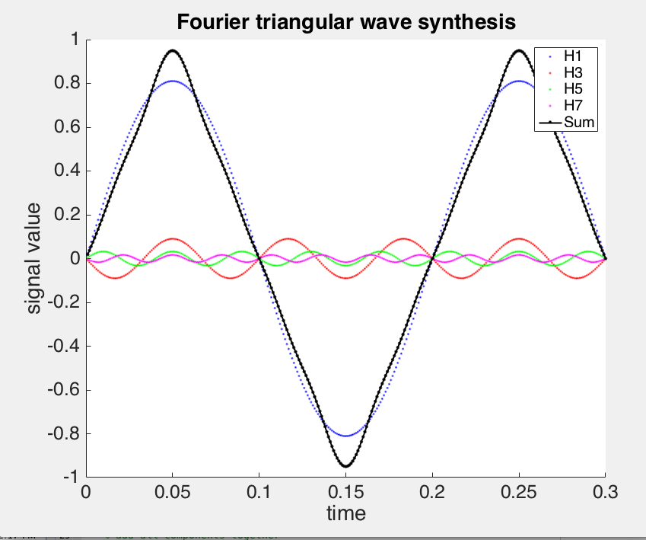
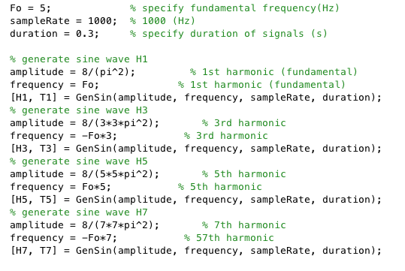
Synthesize a square wave in Matlab
The Fourier decomposition of a triangular wave is given by

Slide 65
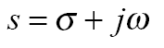
Laplace versus Fourier transform
Laplace transform:
where
Fourier transform:
Setting s=jω in F(s) yields the Fourier transform of f (t)!
NB: Fourier Transform is often used for signals that exist for t<0)
The frequency response in the entire right-half s- plane with s=-j∞ to s=+j∞ is the critical section of the Nyquist contour

Slide 66
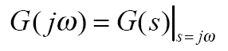
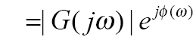
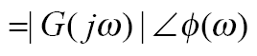
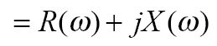
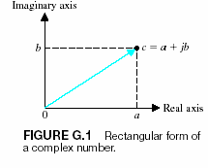
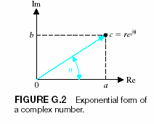
Frequency response plots
Can substitute s = jω to get frequency response from transfer function
Exponential representation
Angle and modulus representation
Complex representation

Slide 67
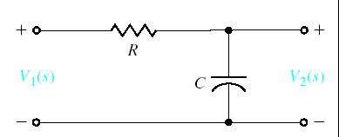
RC network: 1st order frequency response
Consider voltages in RC network
Talking Laplace transforms
Transfer function for RC network

Slide 68
RC network: 1st order frequency response
From transfer function
Frequency response is
Writing
gives
NB: RC is time constant equivalent freq in Hz

Slide 69
RC network: 1st order frequency response
Splitting into real and imaginary components
Modulus of a complex number is given by
As

Slide 70
ROCO218: Control Engineering Dr Ian Howard Lecture 3 Bode plots

Slide 71
dB Scale
The decibel is a logarithmic unit used to express the ratio of one value of a physical property to another value
To express ratios of amplitudes of signals, the decibel (dB) quantity is given by the expression
SignalAmp_{mes} is the measured signal amplitude value
SignalAmp_{ref} is a reference amplitude value (which can be 1)
NB: to compute power ratios, a scaling factor of 10 is used instead of a scaling factor of 20
SignalPow_{mes} is the measured signal power value
SignalPow_{ref} is a reference power value (which can be 1)

Slide 72
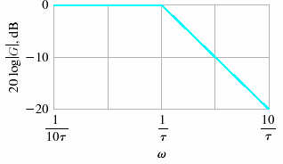
Bode Diagram
PA Bode plot shows the response in dB again log frequency
Advantage of logarithmic plot is that multiplicative factors are converted into additive ones
We can then decompose a high order transfer function into a product of simple standard components to sketch the broad features of the Bode diagram

Slide 73
1st order roll-off
A frequency increases by an octave when its value doubles
Consider the effect on a system with a 1st order transfer function
As frequency becomes large, the s term will dominate as the ‘a’ term will become insignificant. and the system behaves like an integrator
So amplitude of the transfer function becomes

Slide 74
1st order roll-off
Therefore the dB ratio of responses when frequency increases by an octave is given by
where
Thus for a 1st order system, the response falls off 6dB per octave

Slide 75
1st order roll-off
For a 1st order HPF characteristic
A 1st HPF characteristic would thus give +6dB/Octave increase
NB: change in 1st order LP system response per decade is would be 20dB

Slide 76
1st and 2nd order roll-off
Form of transfer function
Asymptotic roll-off per octave
1st order low pass characteristic
1st order high pass characteristic
2nd order low pass characteristic
2nd order high pass characteristic
In general, asymptotic roll-off is 6dB per octave per order

Slide 77
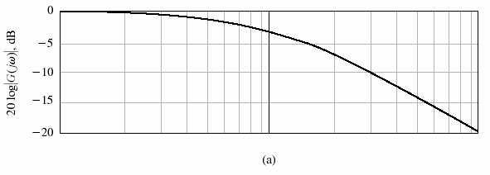
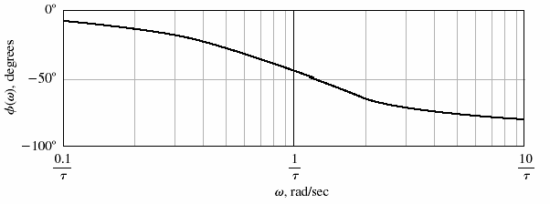
Bode Diagram
AMPLITUDE
PHASE

Slide 78
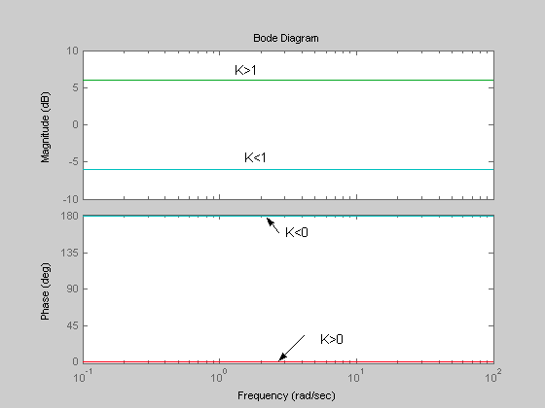
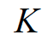
Factors in transfer function:
Constant
Flat amplitude
and phase responses
A direct connection

Slide 79
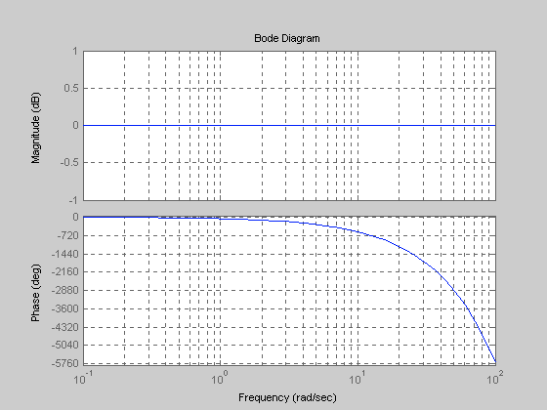
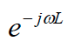
Factors in transfer function:
Transport delay
Flat amplitude response
Frequency dependent
phase responses

Slide 80
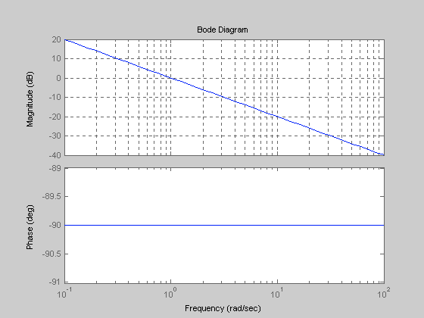
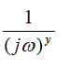
Factors in transfer function:
Integrators
Reduced amplitude
response with frequency
Integrators have a -90°phase responses
Output lags input

Slide 81
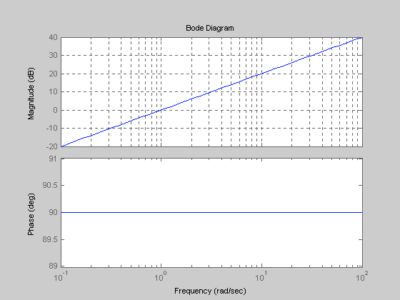
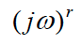
Factors in transfer function:
Differentiators
Increasing amplitude
response with frequency
Differentiators have +90°phase responses
Output leads input

Slide 82
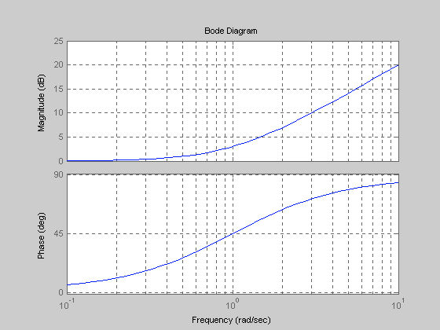
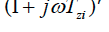
Factors in transfer function:
First order lead terms (real zeros)
Increasing amplitude
response with frequency
Frequency dependent
Phase
- High pass filter

Slide 83
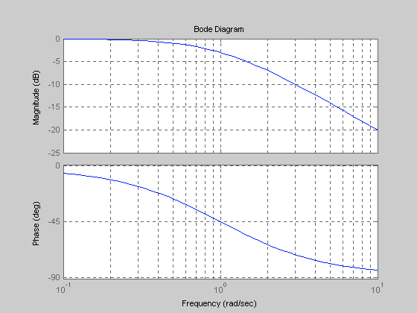

Factors in transfer function:
First order lag terms (real poles)
Decreasing amplitude
response with frequency
Frequency dependent
phase
= Low pass filter

Slide 84

Gain and phase margins
K a variable (constant) gain
G(s) is the plant under consideration
The gain margin is defined as the change in open-loop gain required to make the system unstable
The phase margin is defined as the change in open-loop phase shift required to make a closed-loop system unstable
Feedback system goes unstable when we get positive feedback!

Slide 85

Gain and Phase Margins on the Bode Diagram
Extra gain that will give 0dB
at -180 degree phase shift
Gain Margin
Phase Margin
Extra phase that will give
-180 degree phase shift at 0dB gain

